Slide 1


Gender and Multiplicity

Slide 2

Content Warnings:
Mentions of transphobia
Discussions of trauma, abuse & mistreatment

Slide 3





About Me
I am ..
A PlayStation Vita homebrew dev.
“Android or iOS?” obviously Symbian.
An enjoyer of old mobile phones.
A human rights advocate
(but like for real; no ‘unless the state decides you don’t have rights’ nonsense)
But I am also…
A Dx’d DID System of 11.
Transgender
on HRT.
A cute girl; made of crystals.
Notes:
Probably best to skip this slide if you are not sure Li is fronting, or maybe give a notice that this is about your host and not you specifically;
Assuming im still Li when presenting:
-> Try not to go on a rant about how harming other people isnt actually okay, or how things arent magically fine because the state does them; or how the state is the biggest threat to human rights to ever exist.. this presentation isn’t anarchism 101, (plus you don’t have the CW’s for that!)
-> Try to stay on topic and be brief when talking about yourself, its nice to know, but its not the main focus
-> Don’t go on a tangent about Symbian OS, the PS Vita, or anything like that either, *I GOT THIS*
Despite breif mentions and showing of their phones; this presentation is not endorsed by or affiliated with
Nokia ;or The Symbian Foundation.

Slide 4

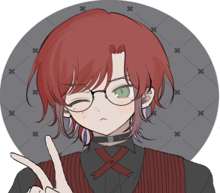
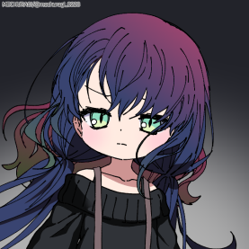
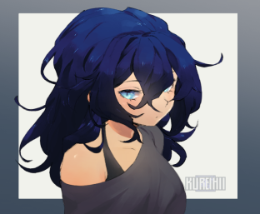
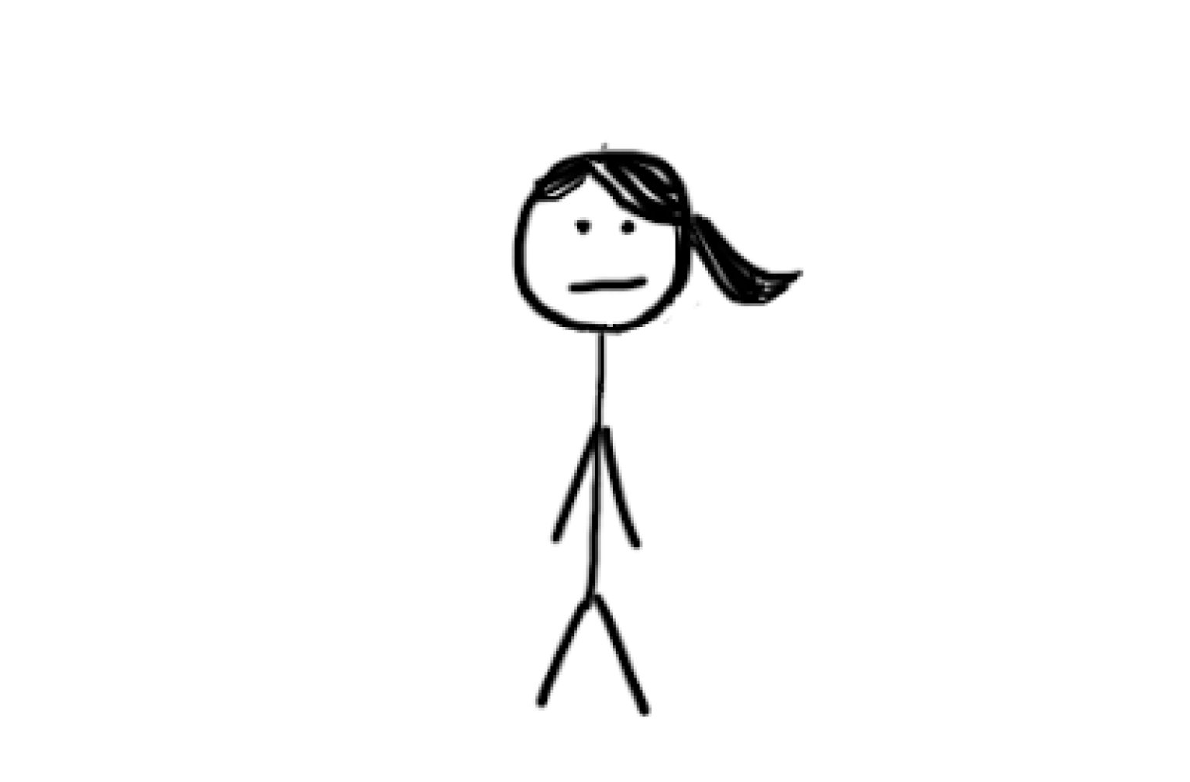

Plurality 101:
Many individuals in one body
Said identities are called “alters” or “headmates”
The collection of them is called a “system”.
Typically you will switch between them or ‘take turns’ being
‘in front’
Being a blend of many is also possible.
Usually involuntary.
Notes:
Breifly Explain what plurality is
Go over how you switch between various identities states
Explain common terminology

Slide 5
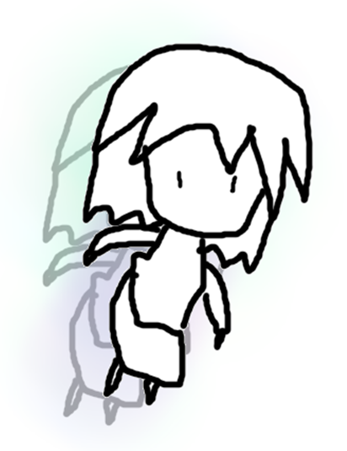

How does this happen?
Dissociative Identity Disorder:
In the DSM-5 ™
Two or more identity states*
Caused by trauma in childhood
Typically includes memory issues and
lack of control of what happens;
Endogenic:
Community Label
The “Non-Binary” of plurality
Variety of causes (‘just happens’, spiritual praxis, intentional via tulpamancy; etc)
Typically, less memory issues, typically have control over when you switch, what happens, etc,
Notes:
Although I mostly only know about DID and have experience with that, I didn’t want to come at this from purely that as a basis;
Endogenic plurality is a non-clinical non-disordered approach to identity, where you feel as though you are multiple identities or have multiple sense of selves
Complete with system medicalism and gatekeeping,
Another system friend of mine wanted me to mention tulpamancy a bit.

Slide 6
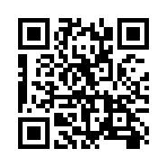
Trans people & DID.
Diagnosis | Transgender population n=10,270 (%) | Control population n=53,449,400 (%)
Dissociative disorder | 130 (1.3) | 51,690 (0.10)
Anxiety disorder | 3220 (31) | 3,194,050 (6.0)
Post-traumatic stress disorder | 690 (6.7) | 275,730 (0.52)
ADHD | 1070 (10) | 916,370 (1.7)
Autism | 150 (1.5) | 83,760 (0.16)
* Trans people more likely to have PTSD, and also DID; likely because of transphobia,
* Prevalence of DD’s in trans people, is about as high as that of autism?
* Gender Dysphoria is itself kind of a dissociative experience!
Much statistics
Source:
Mental Health Diagnoses Among Transgender Patients in the Clinical Setting: An All-Payer Electronic Health Record Study
https://pmc.ncbi.nlm.nih.gov/articles/PMC6830528/
Notes:
I couldn’t find much information about this honestly, only a few studies that were even relevant
(This was the least transphobic one)
“Dissociative symptoms in individuals with gender dysphoria: Is the elevated prevalence real?” is also maybe a bit relevant, but it uses clinical misgendering (referring to trans women as ‘males’) and for some reason(?) tries to define orientation with assigned gender, rather than actual gender, and some mentions of gatekeeping hrt access,
That and it didn’t actually show how much was in the control population, just what % of people with GD they mentioned had dissociative symptoms (according to DES- and DIS-); which is still interesting, it also highlights that gender dysphoria is a kinda dissociative experience to start with, which I agree; and also crucially gave information about how many report mistreatment or abuse in childhood, which is also a factor for DID,
Hopefully, I can remember to mention that in particular when I get here, there was a version of this slide that used that data, but I spent too long explaining it’s issues that I honestly just cut it out and found the only other relevant thing
In general, id love to see more research on this <3

Slide 7


Plurality & Gender
Alters can have different gender & orientations,
Many systems think their ‘just genderfluid’ early on,
In genderfluidity just your gender changes; in a system everything changes, and gender is merely ‘coming along or the ride’.
Despite this- one could still consider the system as a whole to be
‘kind of’ genderfluid.
It Even has a microLABEL
Very Gender
Notes:
DID is often kind of trans implicitly by how it functions, but also being trans is kinda dissociative in how it functions too;
Another good thing to mention could be that structural dissociation also kind of shows the existence of trans people, as it suggests kids develop their identity around ages 6-9-ish,
when they start getting a sense of self and a sense of who they are, (this is why typically, DID can only happen if traumatic things happens around this time, or before it);
which is around the same time, that we see kids identifying that they are transgender; further showing that -> this is just human development.
And not some weird ploy to ‘push’ kids into being trans or anything;
Could talk about how many systems (including myself) thought they were just genderfluid early on because of this, but also the label never quite really ‘fit’ either.

Slide 8

Passive Influence
The way in which one alter can influence or effect another,
This happens passively, and on own,
Is often a sign a given alter alter is ‘close to front’
Can be more than just thoughts or words, but emotions, actions, interests, desires, etc-
Is hard to fully understand, even harder to notice,
even for systems, even if when it’s is happening to you.
-> Can temporarily mess with your sense of gender and orientation!
Notes:
Maybe provide an example? I swear not enough space on slides xS
Example: were outside wearing a skirt, Mia came close and we wanted to be more androgynous suddenly; (I think we also switched around then?)
(maybe make up an example instead of using a personal one, I don’t know..)

Slide 9
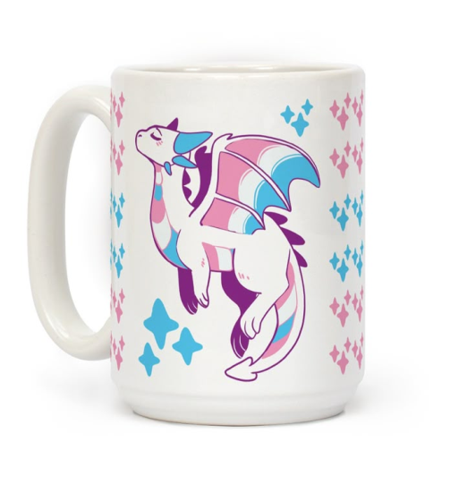
How to treat systems
Some alters may prefer to go by different names & pronouns to other alters
The system as a whole might use collective name, or collective pronouns (i& you&)
We often use plural first person pronouns, like “we” or “us” when referring to ourselves
Do not ask a system to switch, or to be a specific alter at any given time, it gives off an impression that you only like one of us; not only that but often don’t have much control over it
Avoid host-centralism, none of us are more real
or important; and the ‘host’ is just another alter.
And of course the golden rule
-> Treat people how they want to be treated ™
Notes:
“Treat people how they want to be treated” while true in all cases; needs more nuance, that I cannot fit into one slide, so I split it into two
Tl;dr trauma is hard,

Slide 10
But wait.. Nuance?
Although you should always treat others how they wish to be treated,
Trauma is hard, and so there are a few things to consider:
Traumatized individuals in general; can have a hard time expressing what they are and are not comfortable with.
Don’t assume anything, a lack of disapproval, is not approval.
Always ask! In a non-demanding way, show kindness and understanding and allow room for us to have autonomy, and to be comfortable,
Assure us that ‘no’.. is an acceptable answer; as for many of us it just simply wasn’t.
We may distrusting or skeptical of you; even if your being nice; this is not anything against you, it’s just a learned response to years of mistreatment.
Please don’t use this to try ‘speak for’ us, or to decide things for us.
I’ve had enough of that already I can assure you; i don’t need more of it.
Notes:
this also would apply to PTSD/CPTSD, etc.
> Maybe talk about how it can be hard to talk about how you want to be treated, because we often were not allowed too, were expected to just be *okay* with mistreatment, and speaking up would lead us to come to further harm, so we have _learned_ not too, and this can be very hard to unlearn;
We personally have experience with this; we have whole alters who’s entire thing was just to persevere through uncomfortable and generally bad situations;
Who would come out whenever we weren’t comfortable with anything, or when we weren’t okay with something,
and would just act as if everything is fine and nothing is wrong, and it is really hard to tell what they are and are not okay with externally,

Slide 11
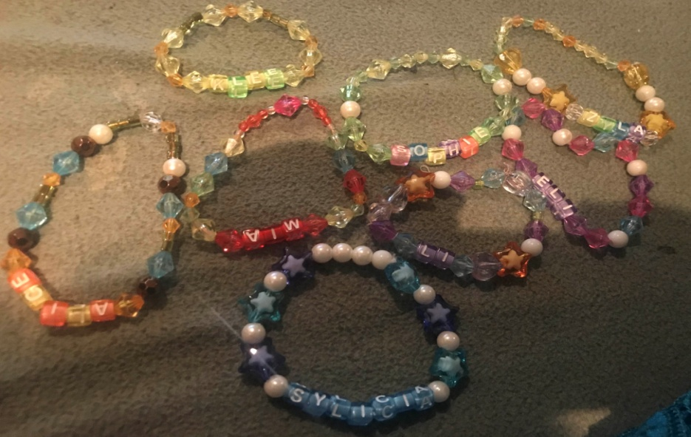
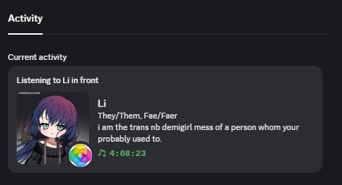
Fronting Indicators
Sometimes systems will have ways of sharing who is currently fronting at any given time.
Bracelets, Necklaces, other jewelry
Wearing name tags
Different clothing items
You may also see some examples online;
Simply Plural
PluralKit
Octocon
PluralRichPresence
Notes:
this relies on cooperation between alters and different fronters; and some degree of working together, which may not always be present;
We also may desire privacy or otherwise opt to not share this in certain situations, for various reasons.

Slide 12

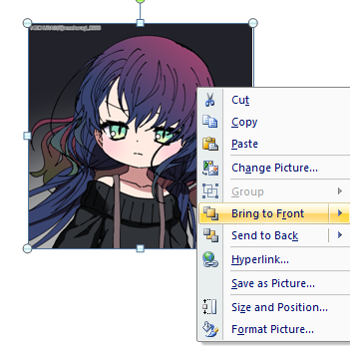


Any Questions?
Hell Yeah, Q & A Slide

