Slide 1
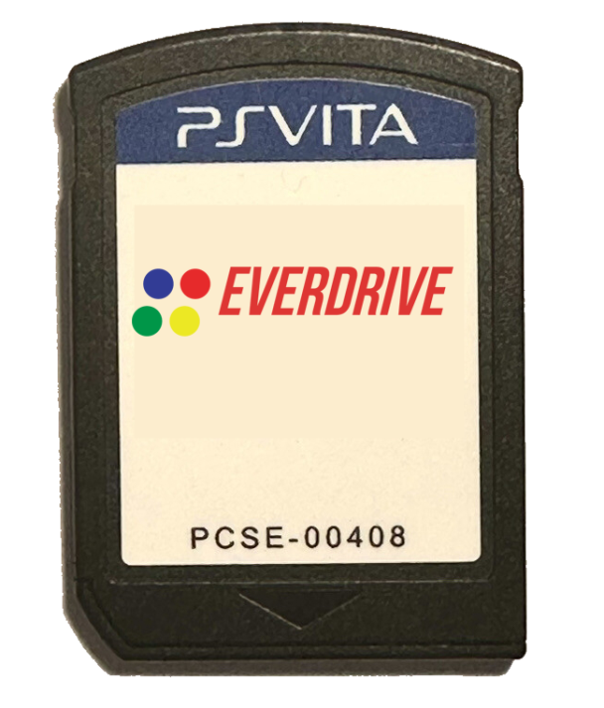
How to (theoretically) create vita flash cartridges
(or bootleg games)

Slide 2
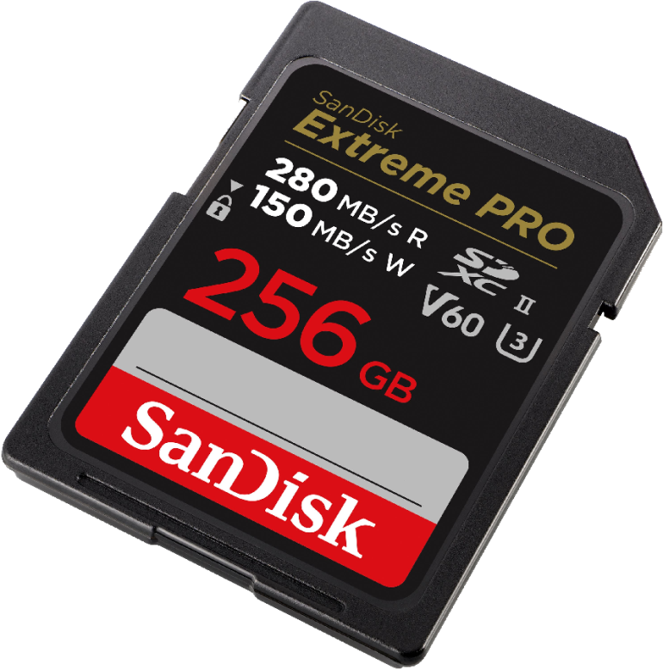
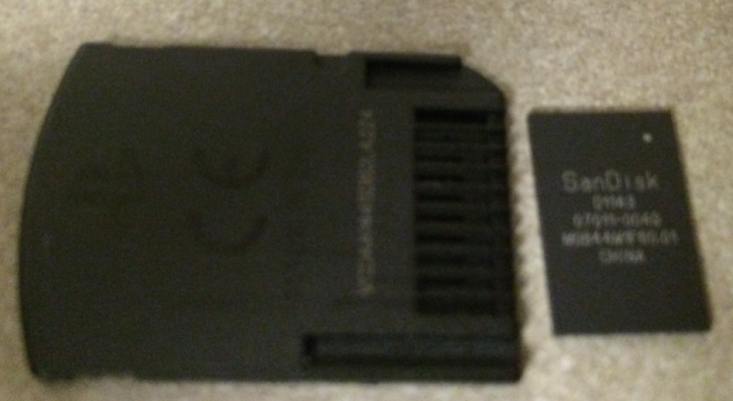
How Vita Game carts work
JUST a standard eMMC / SD card;
With a custom firmware …
And a different shape
Authentication over CMD56
Developed by SanDisk <3

Slide 3
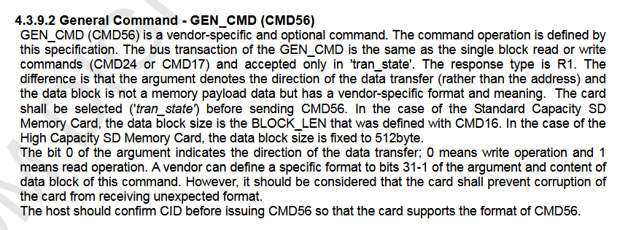
CMD56
MMC defines standard ‘commands’ w numerical IDs
eg; CMD24 is read block, CMD17 is write block..
CMD56 is “General Command” or “GEN_CMD”
- SD Specifications: Part 1 Physical Layer Specification

Slide 4
TL;DR
Its whatever the manufacturer wants it to be…
If we want to make our own carts …
Then we must understand how its being used..
We must play along …

Slide 5
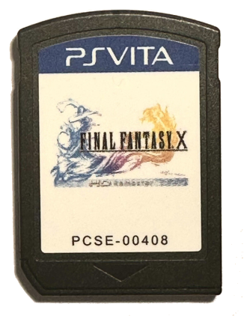
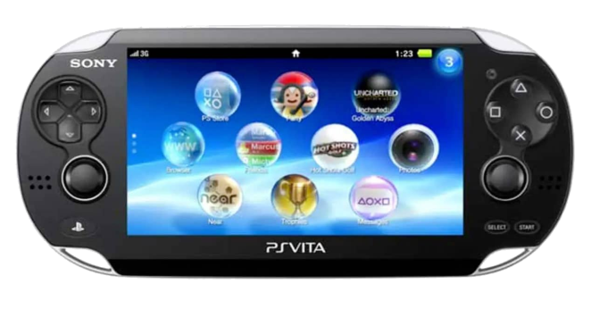
CMD56: An overview.
The console sends a request
… then the card sends a response
request
response
And a whole lot of cryptography …

Slide 6
In the beginning….
Vita sends START (0xC4) request …
Cart responds with 00000000000000000000000000010104
That’s it … (really)
… moving on

Slide 7
Card Locking …
Vita sends GET_STATUS (0xC2)
Card responds with STATUS_LOCKED …
This is a security feature:
Contents of the cart cannot be read, until the authentication is done,
This request is to query the status of the card, if it can be read.
As the cart was just inserted, it will always report that it is locked.

Slide 8

Give me a session key
Vita sends GENERATE_SESSION_KEY (0xA1) request.
Card responds w random bytes
Both card & vita then encrypt with BIGMAC 0x348
Encrypt result is the session key
*

Slide 9
A tangent: BIGMAC
BIGMAC keys are crypto keys sealed in hardware
Can be used, but not read from software
Only accessible to security co-processor (F00D)
When I say ‘bigmac 0x348’ I mean;
the 348th key in the bigmac keyring,
We do not know what this key actually is …
*

Slide 10
Vita has a random too…
Vita sends random data, with EXCHANGE_SHARED_RANDOM (0xA2)
Card responds with vita random encrypted w session_key
This is a security feature:
This ensures both the cart knows the correct session key;
.. As the session key is derived from BIGMAC 0x348, (which the cart also has on it)
the security of gamecarts depends on it this not being known.
If the value sent back does not match the random the vita sent,
The cart is deemed illegitmate and the game wont start.
*

Slide 11
Cart validates it too
Vita sends EXCHANGE_SECONDARY_KEY_AND_VERIFY_SESSION (0xA3)
Previous card random + previous vita random, encrypted with the session key
Cart decrypts and compares, gives either success or fail code.
This is a security feature:
This ensures both the cart and the vita know the session key; previously the vita verified the cart, but this is to attempt to stop cart dumpers;
If the value sent back does not match the random the vita sent, the cart sends a fail response, and the cart remains locked, if it does, the cart will unlock it
*

Slide 12

Conclusion
Creating a custom cart would requires knowledge of bigmac 0x348;
Extracting 0x348 is nearly impossible;
Therefore creating a flashcart or cloning carts, is nearly impossible.
-

Slide 13
VULNERABILITIES
☺
Things are not always as they seem ….

Slide 14

Remember when …
I said .. “Card responds w random bytes“
What if it didn’t?
What if …
0xAAAAAAAAAAAAAAAAAA

Slide 15
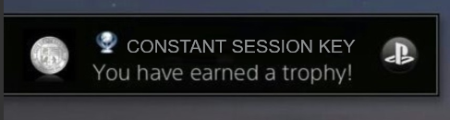
In this case …
0xAA .. encrypted w bigmac 0x348;
… Session key would be the same every time
Resulting value can then be calculated ahead-of-time on a hacked console …
.. and so we can break the authentication

Slide 16
NOT SO FAST!
Unfortunately; Sony thought of this …
result of bigmac keyring encrypt,
are always into other bigmac keyrings,
(0x24 in this case)
So would have to extract the result keyring somehow first ..
.. So we are back where we started.

Slide 17
I had .. left out some stuff;
This is way more overly complicated, so I left it out.
Card sends random bytes, and a ‘keyid’ either, 0x1, 0x8001, 0x8002, or 0x8003;
Vita selects a ‘keyseed’ based on keyid; and the keyseed is encrypted with 0x345. (into key 0x21)
Encrypt result then used to encrypt the card random;
Finally, result of card random encrypt is encrypted with 0x348 (into 0x24)
if (keyid == 1)
CAN BE SKIPPED !!!

Slide 18
The key id revolution …
With a combination of using keyid 0x8001, 0x8002, or 0x8003;
AND always using a constant card random.
… NOW the session key is NOT stored in a keyring; And can be extracted ..
Foiled again …
GcAuthMgr checks if keyid < 0x8001,
.. refuses to run if it is …

Slide 19
The key id revolution …
Foiled again …
GcAuthMgr checks if keyid < 0x8001,
.. refuses to run if it is …
… … it checks less than 0x8001 ..
not LESS THAN OR EQUAL …
Using exactly keyid 0x8001.. is still allowed …

Slide 20
… This is pointless btw …
Davee found a exploit in bigmac called the ‘racoon exploit’ awhile ago
It allows you to extract result from bigmac key encrypt …
So, you can actually use keyid 0x1 anyway;

Slide 21
… This is extra pointless …
In the time since looking into this, all bigmac keys have been extracted via some
hardware attacks;
0x345: 74C39CA4EF4F122915C71EDA46C88B55BBAD1F4033D755CEA0563CC341F92E66
0x348 : C026281413FA462CCDEED4BD6D08C37CA6C9322ABD4C40ADE72A0F544F4013AD
Just .. Implement the whole thing including the random session key ..
Infact, I kind of already did, I implemented the entire auth, and it works,

Slide 22
Where we are now.
Gamecart auth completley cracked;
Gamecarts can be theretically cloned now
Whats next?
We still need to make a device to actually do the communications
Some possibilities include …
SD with custom firmware
.. reprogrammed to respond to cmd56
SD Proxy / MITM
.. forward everything except cmd56.
Rewrite original carts
Seems unlikely, but would work
No standard way to flash fw
Usually relies on backdoors.
Only works on one chipset
- Requires custom hardware
- Bus is pretty fast (>50mhz)
- Probably needs FPGA
No one knows how
probably impossible
unclear if can rewrite keys

